Slide 1
Control Flow
Rajasekaran S
Assistant Professor,
Department of Information Technology,
KGiSL Institute of Technology,
email: proffraja@gmail.com
Github:www.github.com/rajasekaranap

Slide 2
Control Flow Statements
control flow (or flow of control) is the order in which individual statements, instructions or function calls of an imperative program are executed or evaluated.
Control flow statements, however, break up the flow of execution by employing decision making, looping, and branching, enabling your program to conditionally execute particular blocks of code.

Slide 3
Types Control Flow Statements
Control Flow
Decision Making
Looping
Unconditional Jumps
If - else
for
break
If – elseif - else
while
do-while
continue
switch
for-each

Slide 4
Decision Making
It is used to make decision based on the condition.
It contains two block of codes
if block
else block
If requires Boolean condition [True or False].
If condition passed if block is executed otherwise else block is executed.

Slide 5
Syntax
if (boolean_condition){
//block of code
}
else{
//block of code
}

Slide 6
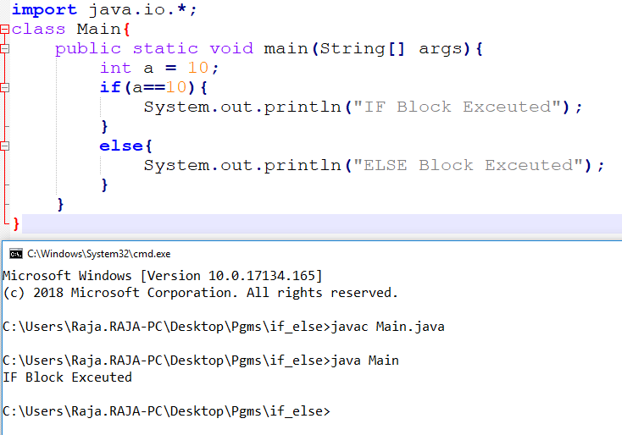
if Block

Slide 7
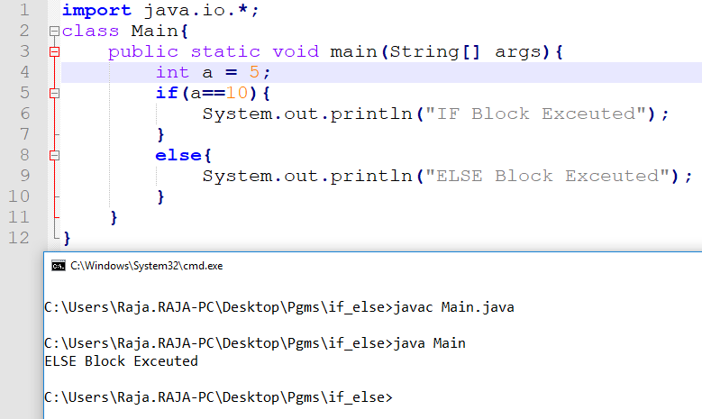
else Block

Slide 8
if – elseif - else
if (boolean_condition){
//block of code
}
else if(boolean_condition2){
//block of code
}
else{
//block of code
}

Slide 9
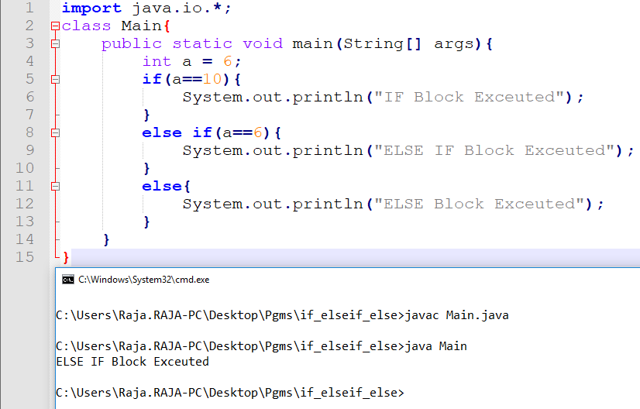
if – elseif - else

Slide 10
Problems
Finding given number is ODD or EVEN.
Greet a person with gender identification.
Finding given number is positive or negative.

Slide 11
Nested IF
The if else contains if else statement is know as nested if else.
if (boolean_condition 1){
//block of code
if(boolean_condition 1.a){
//Inner if block
}
else{
//Inner else block
}
}
else{
//block of code
}

Slide 12
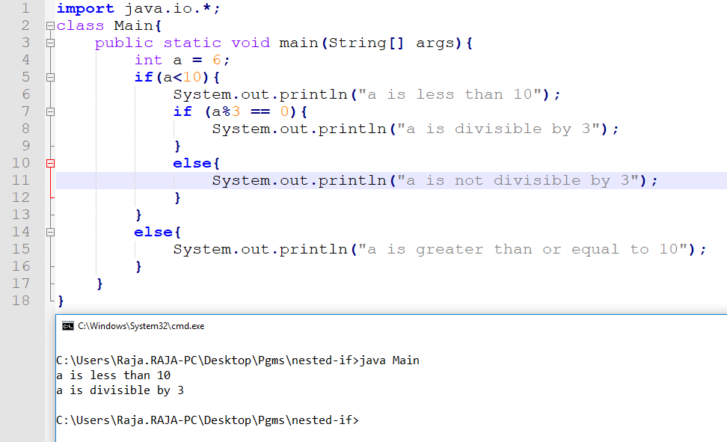
Example [a<10 and div by 3]

Slide 13
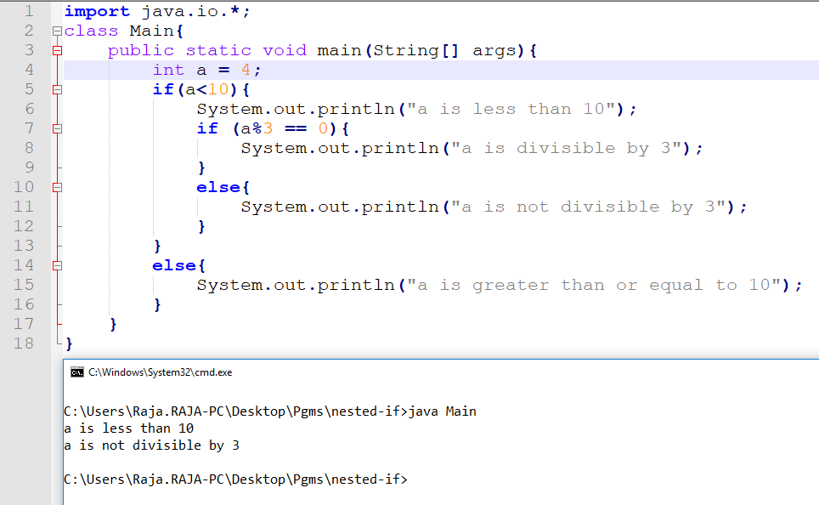
Example [a<10 not div by 3]

Slide 14
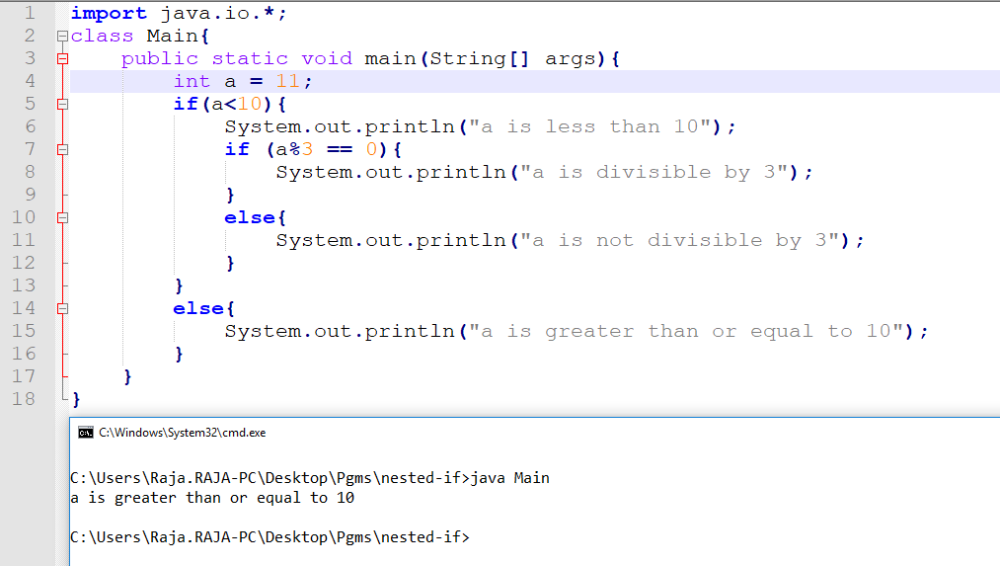
Example [a is not less than 10]

Slide 15
Switch
Matched
Case 1
Statement 1
Break
Unmatched
Matched
Case 2
Statement 2
Break
Unmatched
Matched
Default
Statement default
Break

Slide 16
Syntax
switch(expression) {
case value :
//Statements
break;
case value :
//Statements
break;
default :
//Statements
break;
}

Slide 17
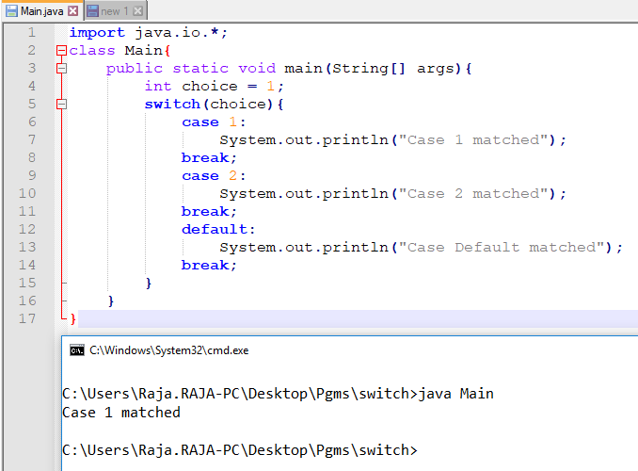
Example [Case 1]

Slide 18
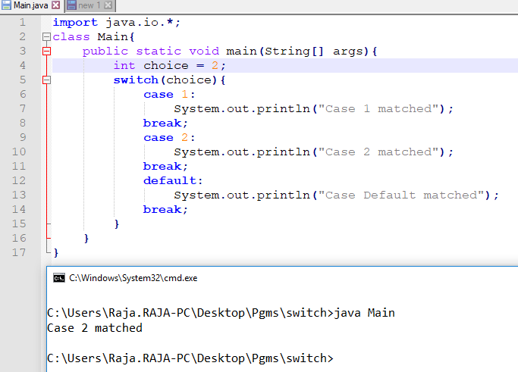
Example [Case 2]

Slide 19
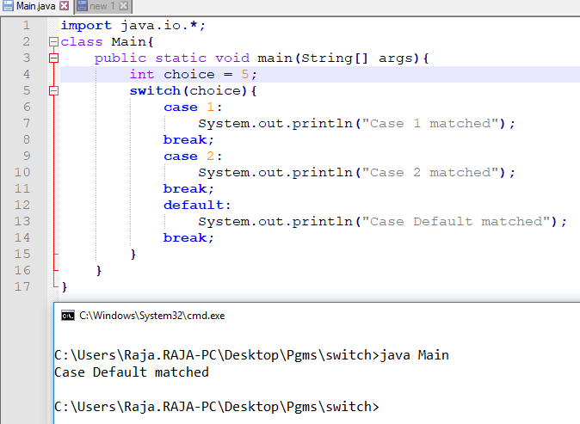
Example [Case Default]

Slide 20
Problem
Create Simple Calculator that gets inputs from user and get the choice of operation and display the results accordingly.

Slide 21
Loops
It is also known as iterate statements.
A block of code is repeatedly executed until some condition is satisfied or true.
There are 2 types of loops
Deterministic Loop
for loop
Non Deterministic Loops
while
do-while

Slide 22
FOR LOOP
For loop is also known as deterministic loop.
The loop contains
Initialization
Condition
Increment/Decrement
Using this we can clearly determine
String of loop.
When it will end
How many iteration may run

Slide 23
Syntax
for(Initialization; Condition; Increment/Decrement)
{
// Statements of for loop
}

Slide 24
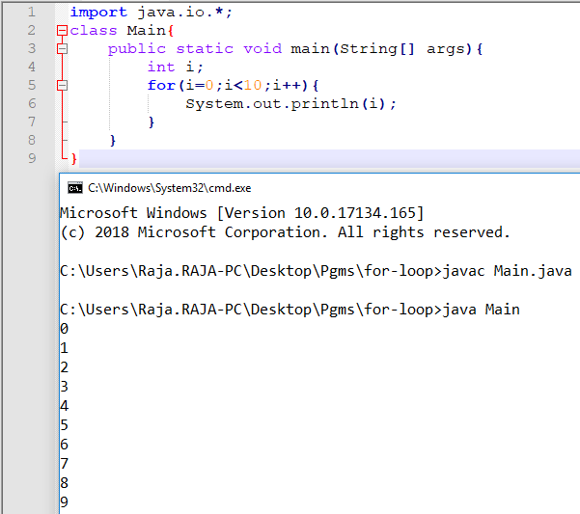
Example [Print 0 to 9]

Slide 25
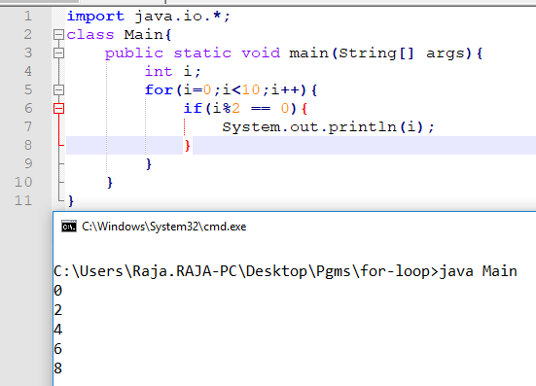
For with if [Printing Even Number]

Slide 26
WHILE LOOP
It is a type of non deterministic loop.
It check’s the condition before entering into the loop.
The block of statement repeatedly execute until the condition remains satisfied.
It is also known as entry control loop.
The condition may or may not satisfied.
We are not sure about the termination of loop and no of iterations.

Slide 27
Syntax
while(Condition){
…
// Block of while loop
…
}

Slide 28
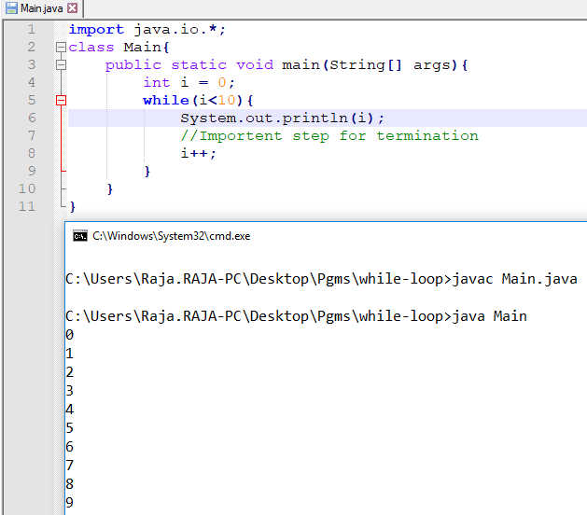
Example [Print 0 to 9]

Slide 29
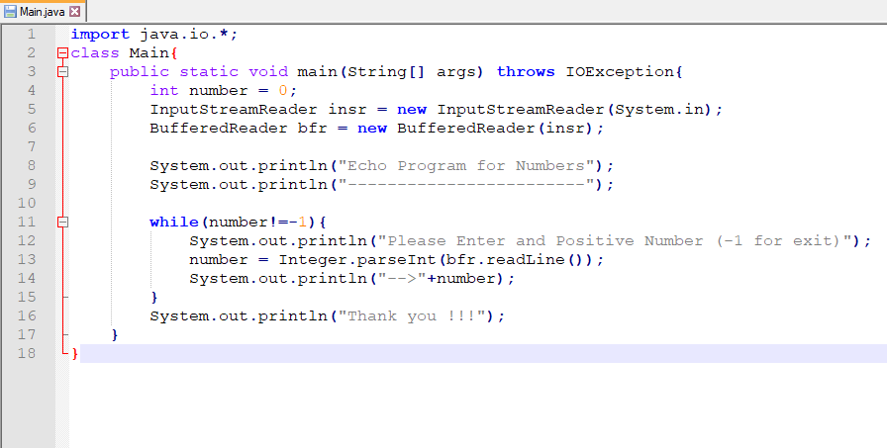
While loop vs User Input
Echo Program for Numbers

Slide 30
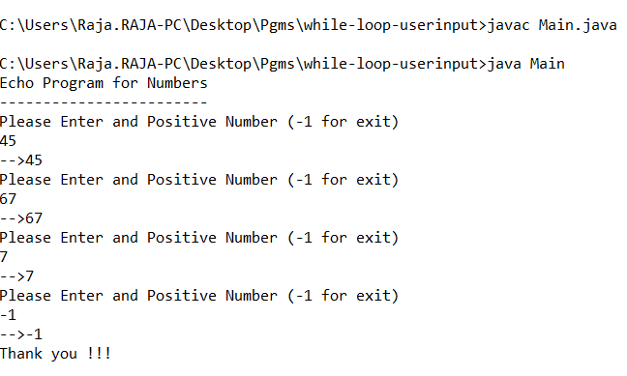
Output

Slide 31
DO-WHILE LOOP
It is also non deterministic loop.
A block of code executed repeatedly until the conditions remains satisfied.
It executes loop block at least once even the condition is not satisfied.
This is also known as exit control loop.

Slide 32
Syntax
do{
…
// Block of do-while loop
…
}while(Condition);

Slide 33
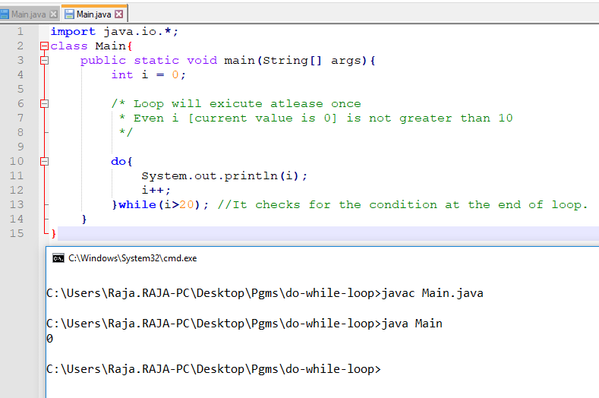
Example Do While

Slide 34
Problem
Extend the Calculator Program [Already done with switch case] for repeated inputs until user wants to exit.

Slide 35
Control Flow
Jump Statements
[Unconditional Jumps]
Rajasekaran S
Assistant Professor,
Department of Information Technology,
KGiSL Institute of Technology,
email: proffraja@gmail.com
Github:www.github.com/rajasekaranap

Slide 36
Unconditional Statements
It transfers the control from one part of the program to another part of the program without any checking of condition.
This statements doesn't have any conditions to verify.
As soon as the execution encounters these statements immediately the jump has been made.
There are two types of statements
Continue
Break

Slide 37
Continue Statement
The continue statement is used in loop control structure when you need to immediately jump to the next iteration of the loop.
It can be used with for loop or while loop.
The Java continue statement is used to continue loop.
It continues the current flow of the program and skips the remaining code at specified condition.

Slide 38
Syntax
loop {
//block of code [stage 1]
continue;
//block of code [stage 2]
}
Stage 2 block will not execute due to the encounter of continue.
It simply moves to begging of the loop.

Slide 39
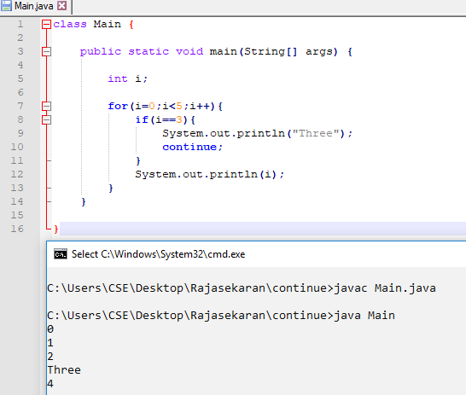
Example

Slide 40
Explanation
Program try to print the numbers from 0 to 4.
Every time loop executes the current value of i is printed.
While we encountering i value is 3.
String “Three” is printed instead of Number 3.
Even consecutive statements [Line 12] has ready print number 3 it is ignored by continue.
Continue statement moves the control to the beginning of the loop so the remaining statements are ignored for that iteration.

Slide 41
Break Statement
It is used to break the flow and moves out the control from current block.
When the break statement is encountered inside a loop, the loop is immediately terminated and the program control resumes at the next statement following the loop.
It can be used to terminate a case in the switch statement (covered in the next chapter).

Slide 42
Syntax
loop {
//block of code [stage 1]
break;
//block of code [stage 2]
}
Stage 2 block will not execute due to the encounter of break.
It simply breaks the loop and there is no more iterations.

Slide 43
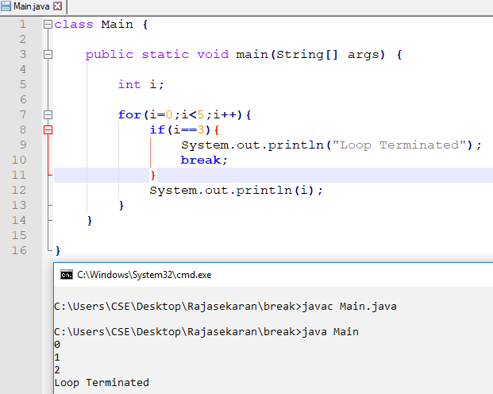
Example

Slide 44
Explanation
Program try to print the numbers from 0 to 4.
Every time loop executes the current value of i is printed.
While we encountering i value is 3.
It prints “Loop Terminated”.
Break Statement is encountered so the loop is terminated immediately.
Even 1 more iterations is available to complete total number of iterations expected but loop is terminated due to break statement.

Slide 45
Thank You
Rajasekaran S
Assistant Professor,
Department of Information Technology,
KGiSL Institute of Technology,
email: proffraja@gmail.com
Github:www.github.com/rajasekaranap

